Slide 1
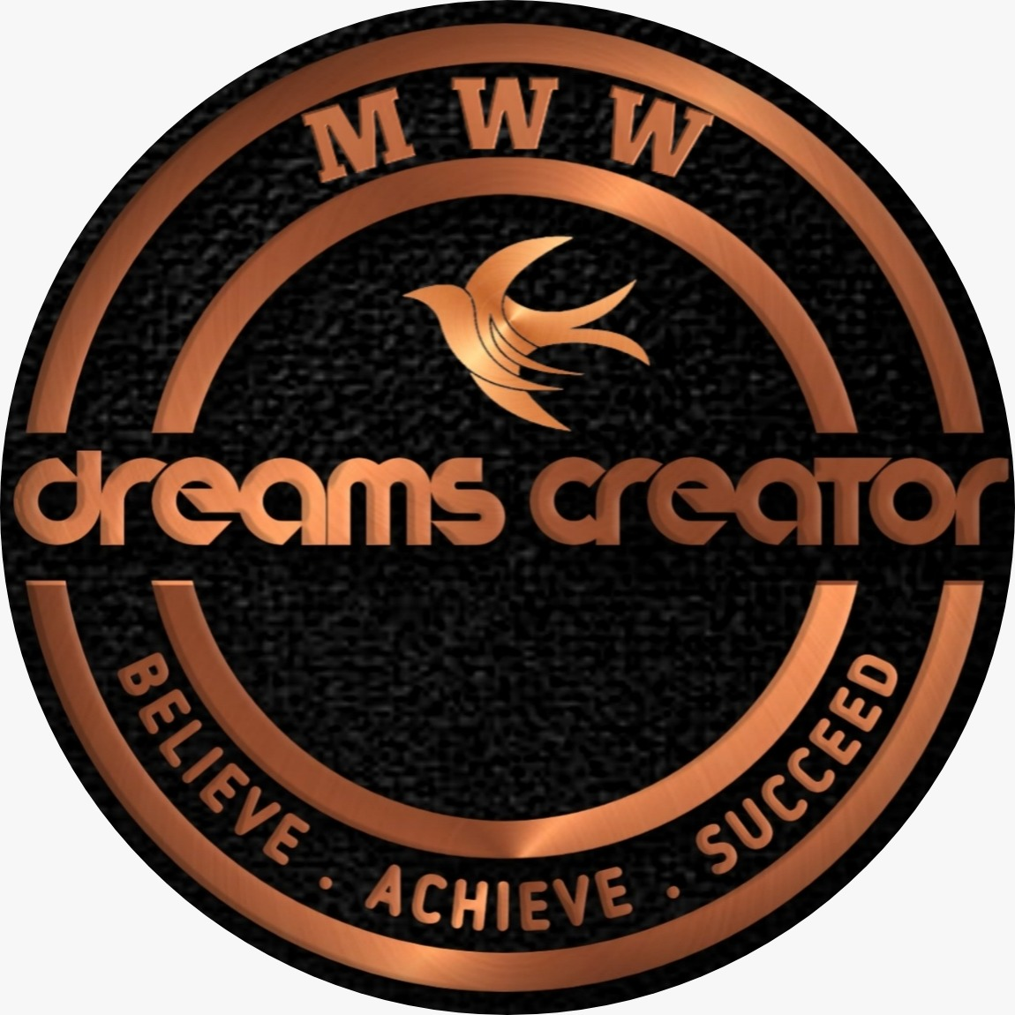
Welcome
Community Orientation Meet
Part – 1

Slide 2
Five Days Community Plan
Part 1 – Introduction
Part 2 – 21st Century Business Model
Part 3 –Common Objections & Solutions
Part 4 - Plan & Benifits of The Business Model
Part 5 – How to Create Passive Income using the System.

Slide 3
Who should not join Community
Someone who is not teachable.
Someone who wants to become billionaire overnight.
Someone who doesn’t have supporting nature.
Someone who don’t love helping others.
Some one who feels money is more important than education.

Slide 4
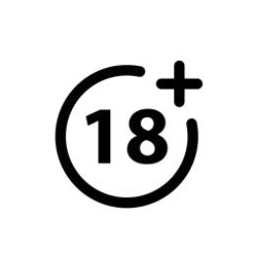
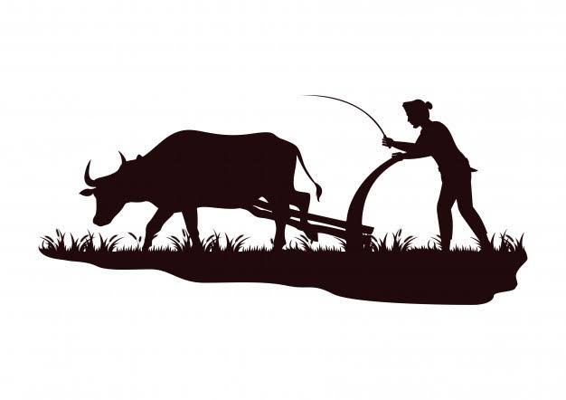
Who can be a part of the community?
HOUSEWIFE
BUSINESS MAN
PROFESSIONAL
DREAMERS
STUDENT
RETIRED
DISABLED
FARMERS

Slide 5
What is the community about?
Introduction
Dreams Creator is a community to connect people all across India and abroad and help people to generate an extra income flow.
Purpose
To help all kind of people to live a life of economy, health and time freedom by developing their skills.
Mission
To help 1000+ people earn a 6 digit income and to make one of the biggest community.

Slide 7
Why we need this community?
Students Full Time Study
No Part Time Job
Wasting Time On Mobile Phone
Low Skill Development
No Personal Development
Lack of Communication Skills
Un identifying Self Skills
No Time Freedom
No Family Bonding
Unfulfilled dreams and goals
Getting Into Bad Habits
Unaware of Passive Income
Mental Health
Stress
Bad Debt
Work Environment For Female & Male
Choosing Your Time
Choosing Your people
Choosing Your Place
Lack of Health Awareness
Borrowing Education Loan
Lack of Financial Knowledge
Flexible Working Hours
Lack of Management Skills

Slide 8
About MWW
Dreams Creator community is associated with Millionaire World Wide education system with help of 21st century business model.

Slide 9
WHO AM I? WHAT IS MY ROLE?

Slide 10
Dreams
Regular Needs
INCOME
Dream House
Luxury Car
Travelling with Family & Friends
Gold and Jewellery
Dream Bike
Children Education
Spending Time With Friends & Family
Financially Strong
Charity
Medicine & Food
Electricity Bill
Water Bill
Petrol & LPG
Mobile Recharge
Education Fees
Daily Essentials
Maintenance Cost
Festival & Function

Slide 11
Current Cash flow…
Important Questions To Ask for Yourself?
You start working at the age of 22
Average working years 40 years
Average Salary =
50000 (Salary) *
12 (Month) *
40 (Years) = 2 Crore 40 Lakhs.
Dream Cost
Total Income Earned
Total Time Spent
Total Family Size
Health Management
Your Present Age
Your Children Age
Within How Many Years You Want To Achieve It?
At What Age You Want to Get Retired?

Slide 12
CAN YOU FULLFILL YOUR DREAMS WITH THAT MUCH MONEY?

Slide 13
IF NOT ACCORDING TO YOUR GOAL HOW MUCH INCOME DO YOU NEED?

Slide 14
HOW MANY YEARS YOU WANT TO WORK JUST LIKE YOUR PARENTS 35 – 40 YEARS?
(Still with bad debt)

Slide 15
OR WORK FOR 5 YEARS AND EARN FOR LIFETIME?
What will you choose?

Slide 16
India’s Upcoming Business Model
Food Industry – Billion Dollar Industry.
Wellness Industry - 80,000 Crore for 2021 F.Y
Digital Marketing - 2,00,000 Crore By 2025 F.Y (Estimated)
Network Marketing - 64, 500 Crore By 2025 F.Y (Estimated)
95% of the shopping pattern will change to online shopping.

Slide 17
Ever You heard day to day Consumption Pattern can change into Income flow, Creates Assets and Passive income for upto next Generations ??
Yes / No

Slide 18
According to the new changes adopting will be better
Now or Later?

Slide 19
Have you heard that your day to day consumption pattern can change into Income Flow and Create Assets and Passive Income for upto next Generations ?

Slide 20
Isn’t intresting to know how to save your own money & Earn Wealth without disturbing present profession ?

Slide 21
21st Century Business Model Gives You 20+ Benefits
No Investment to Start
No Educational Background to start
No Maintenance Cost
No Equipment Needed
No License or Renewal
Exponential Growth - Fast growth
Personality Development
Communication Skills
Public Speaking Skills
It works for our Dreams
National & Global Businesses Expansion
Creates Employments Opportunity
Education & Health
Time Leverage
Problem Solving Skill
Time Freedom

Slide 22
21st Century Business Model Gives You 20+ Benefits
Be Your Brand
Support System from Seniors
National & International Tour
Name, Fame, Recognition & Self Respect
Team Work
Creating Asset for future
Creating Passive income
Creating Legecy
SELECT ANY 3 WHAT YOU LIKE THE MOST ?

Slide 23
What Would Be Your Biggest Dream In Your Life, If Money And Time Is Not An Issue In Your Life?

Slide 24
On Your Present Profession Do You Think You Can Achieve ?
(Yes or No)

Slide 25
What are the other options do You have to make it happen ?

Slide 26
If at all by God Forbid if You are unable to Achieve your Goal how will You feel ??

Slide 27
Are You Ready To Spend Time To Know and to Make it happen?
(Yes or No)

Slide 28
When we talk about Business Few question May arise in our mind before getting involved with us to start a Business..
I have no experience
My parent or family not involved in any business
I do not have Capital to invest to start
I don't know to start I don't know whether my family will support
My background is something different
We have been employee so far
Without big investment how it's possible to earn big money
How it's possible to earn a more income by less working hours
How it's possible while studying. And many more.....

Slide 29
Do not worry Dreams Creator has all the solutions for you.

Slide 30
What’s Next
Let us discuss the 21st Century Business Model.

